Slide 1
CSCE 823 In Class Day 08
ANN Training: Optimization (1)
Live Synchronous session

Slide 2
Agenda
Optimization Challenges
Optimization solutions (part 1)
Coding Activity (initialization & momentum)
Break (if needed)
General Q&A

Slide 3
J(θ) -> Cost of Solution Space
Eigenvalues: all positive all negative some positive, some neg
θ is set of model parameters; J(θ) is cost
Goal: We hope for global minimum
Could be local minimum
High dimensional θ is more likely to yield mostly saddle points
Due to random matrix theory – it is unlikely that in a high-D space, movement in every dimension leads to lower cost
Finding which direction to adjust θ can be challenging

Slide 4
Minima: Local v Global v Saddle (in high-D spaces)
Taking advantage of high-D probabilistic theory…
Saddle points likely to be higher in cost J(θ)
Rationale: one or more vectors lead to lower cost
Local minima in high-D spaces are likely to be low in J(θ) – thus they represent good solutions
Rationale: in a local minimum, movement in any of the many possible dimensions increases cost
Thus: Most (local) minima are good (enough) – especially in big models
If we can’t find which direction to adjust θ, the solution is likely good enough

Slide 5
(new) Interpretation of SGD
SGD usually moves downhill
SGD eventually encounters critical point (…slope ~ 0…)
Usually a saddle point, occasionally a local minimum
Will SGD get stuck forever in a saddle since it fails to exploit negative curvature in saddle? … probably not – it could escape them … But there are optimization challenges which have encouraged researchers to develop improvements

Slide 6
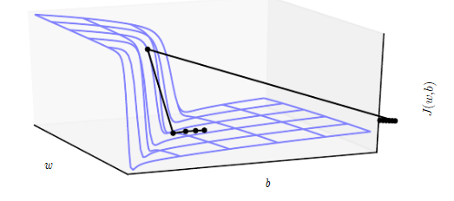
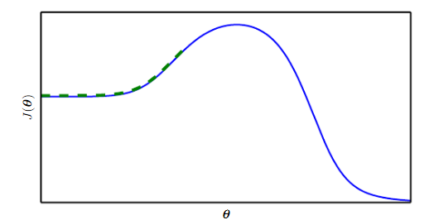
Non-saddle point SGD training challenges
Problems
Solutions
Cliffs and exploding gradients
Local gradient not aligned with global solution
Gradient Clipping
Longer training in higher dimensional search
start
end

Slide 7
Optimization Improvements
Basic SGD w/ learning rate decay (8.3.1)
Momentum (8.3.2)
Nesterov Momentum (8.3.3)
Parameter Initialization (8.4)
AdaGrad (8.5.1)
RMSProp (8.5.2)
Adam (8.5.3)
Newton’s Method
Conjugate Gradient Methods
BFGS
Supervised Pretraining (8.7.4)
Other model improvements (8.7.5)
Batch Normalization (8.7.1)
Continuation Methods and Curriculum Learning

Slide 8
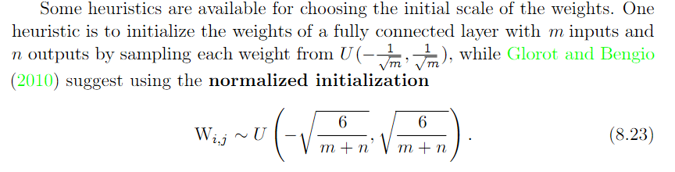
Parameter initialization: Weight
The more layer inputs and outputs, the smaller the initialization values
The weights should be small, but not zero
The expected value of the magnitude of the weights should be related to the number of weights in the layer
The more weights, the lower their expected magnitude

Slide 9
Parameter Initialization: Bias
Bias of output should be set to generate marginal statistics of the target distribution when weights were zeroed – so…
Set all biases to 0 unless…
ReLU - Avoid ReLU saturation: set to 0.1
Gates (e.g. LSTM/GRU) - Set biases which act as gates to 1 so the gate starts open

Slide 10
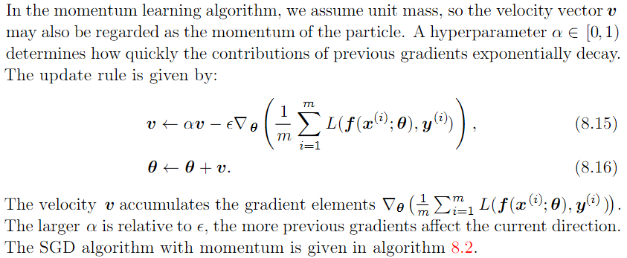
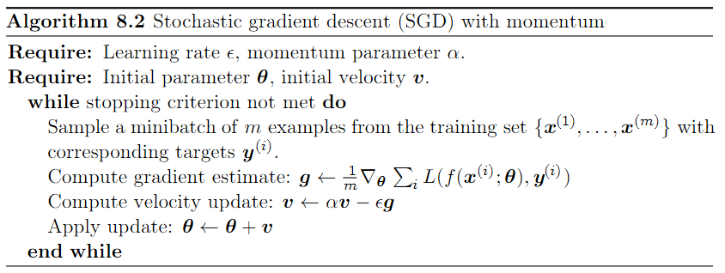
SGD w/ Momentum
Gradient of the loss w/r/t parameters
Velocity
Velocity is an array with the same shape as the network parameters

Slide 11
Learning Activity 20-minute breakout groups
Implement Glorot weight parameter initialization strategy
Modify SGD:
Add momentum to SGD
Conduct an experiment solving XOR with multiple factors/levels (20 reps per condition)
Small network v. larger network
Regular param init v. Glorot init
With Momentum v. Without Momentum

Slide 12
Break

Slide 13
General Q&A

Slide 14
Backup Slides

Slide 15
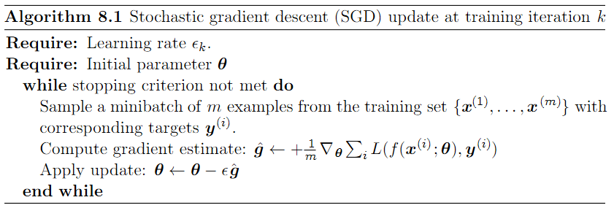
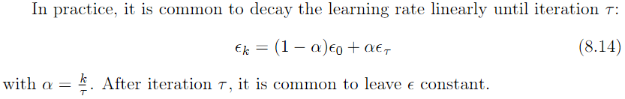
SGD, learning rate decay

Slide 16
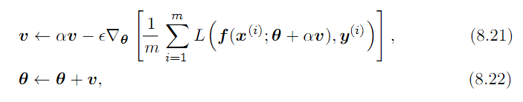
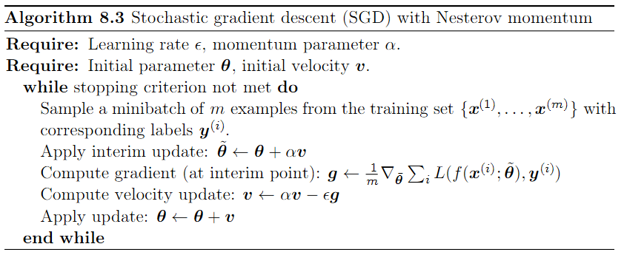
SGD w/ Nesterov momentum
Uses parameter values estimated given current momentum

